Slide 1
Module 4.1:
Explainable ML
Explaining automated decisions in cybersecurity
ML for Cybersecurity

Slide 2
Adversaries
Ethics
Attacker’s goals
Attacker’s capabilities
Robustness of model/feature
Privacy
Fairness
Transparency
Modules 2 – 4
Module 4
Module 2
Module 1
Identify Goals & Collect Data
Data Representation
Modeling
Deployment
Pinpoint needs
Data acquisition
Data labeling
Data exploration
Data cleaning
Missing data
Feature selection
Consider fairness
Efficiency
Accuracy
Interpretability
Adversarial resistance
Performance
Evasion and attacks
Model drift
Impact on stakeholders
Module 3

Slide 3
Adversaries
Ethics
Attacker’s goals
Attacker’s capabilities
Robustness of model/feature
Privacy
Fairness
Transparency
Modules 2 – 4
Module 4
Module 2
Module 1
Identify Goals & Collect Data
Data Representation
Modeling
Deployment
Pinpoint needs
Data acquisition
Data labeling
Data exploration
Data cleaning
Missing data
Feature selection
Consider fairness
Efficiency
Accuracy
Interpretability
Adversarial resistance
Performance
Evasion and attacks
Model drift
Impact on stakeholders
Module 3

Slide 4
The Right (?) to an Explanation
GDPR: “Processing should be subject to suitable safeguards, which should include specific information to the data subject and the right to obtain human intervention, to express his or her point of view, to obtain an explanation of the decision reached after such assessment and to challenge the decision...”
See https://www.privacy-regulation.eu/en/recital-71-GDPR.htm

Slide 5
The Forms Explanations Take

Slide 6
Potential Audiences
Individual data subjects
All data subjects
Regulators / policymakers
Third parties (e.g., journalists)
Global (model, all data subjects) vs. local (one data subject)

Slide 7
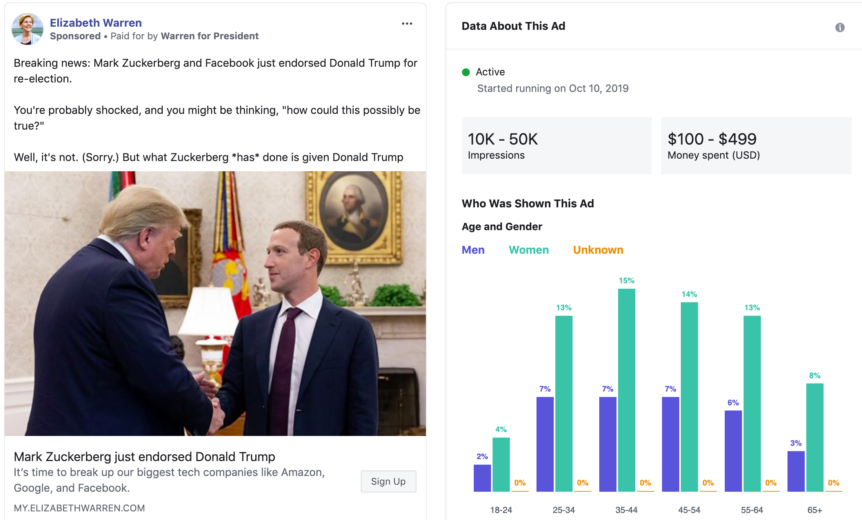
Explaining Ads in Aggregate (Global)

Slide 8
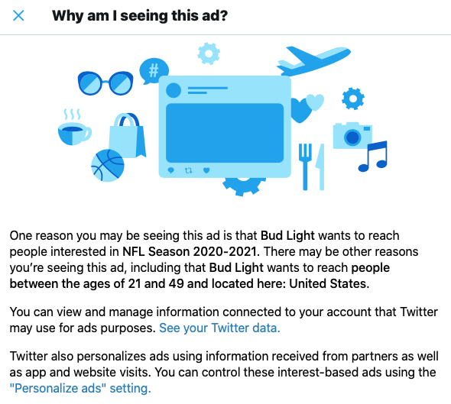
Explaining Ads to Individuals (Local)

Slide 9
Concrete Approaches

Slide 10
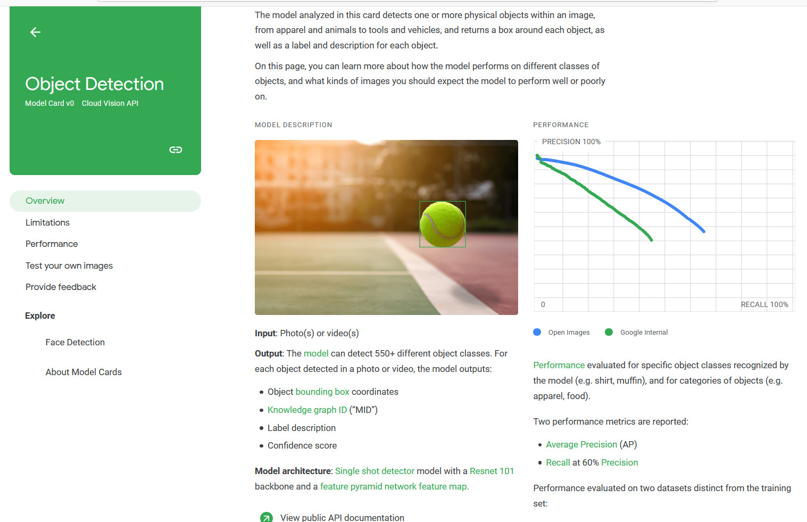
Explaining a Model Abstractly (Global)
https://modelcards.withgoogle.com/ and https://arxiv.org/abs/1810.03993

Slide 11
Models That Are Inherently Interpretable
Decision trees
Port
== 53
!= 53
Packet Size
Not DNS
<= 512
> 512
DNS
Not DNS

Slide 12
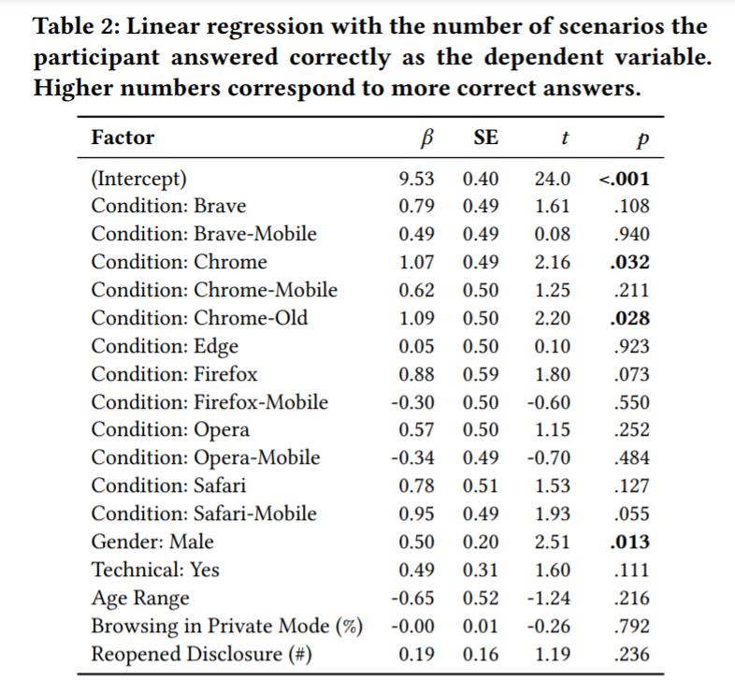
Models That Are Inherently Interpretable
Regression models
Linear regression: coefficients
Logistic regression: odds ratio
Taken from Wu et al. "Your Secrets Are Safe: How Browsers' Explanations Impact Misconceptions About Private Browsing Mode," WWW 2018. https://www.blaseur.com/papers/www18privatebrowsing.pdf

Slide 13
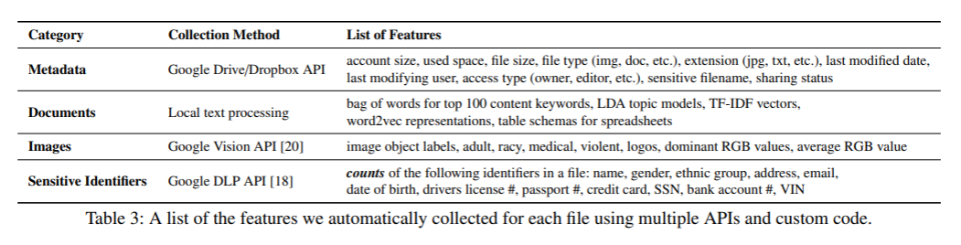
Highlight Important Features
Taken from Khan et al. "Helping Users Automatically Find and Manage Sensitive, Expendable Files in Cloud Storage," USENIX Security 2021. https://www.blaseur.com/papers/usenix21-aletheia.pdf

Slide 14
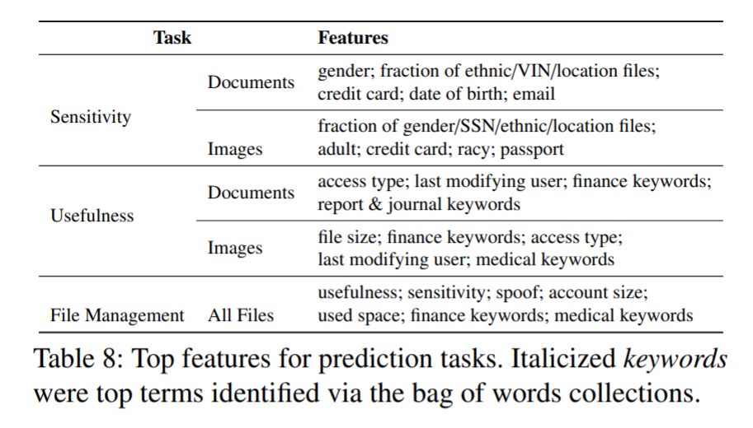
Highlight Important Features
Taken from Khan et al. "Helping Users Automatically Find and Manage Sensitive, Expendable Files in Cloud Storage," USENIX Security 2021. https://www.blaseur.com/papers/usenix21-aletheia.pdf

Slide 15
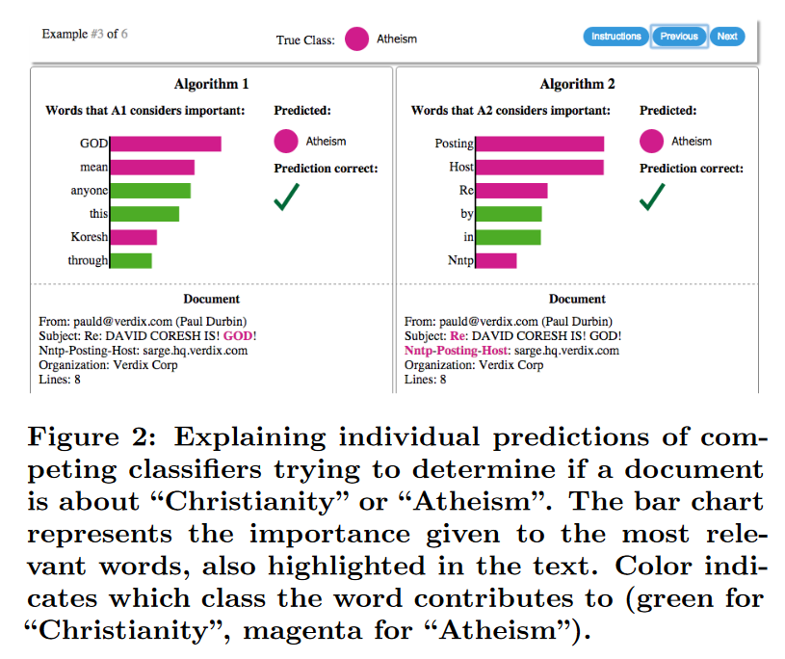
Explaining a Single Text Classification (Local)
Taken from Ribiero et al. “'Why Should I Trust You?' Explaining the Predictions of Any Classifier," KDD 2016 https://dl.acm.org/doi/pdf/10.1145/2939672.2939778

Slide 16
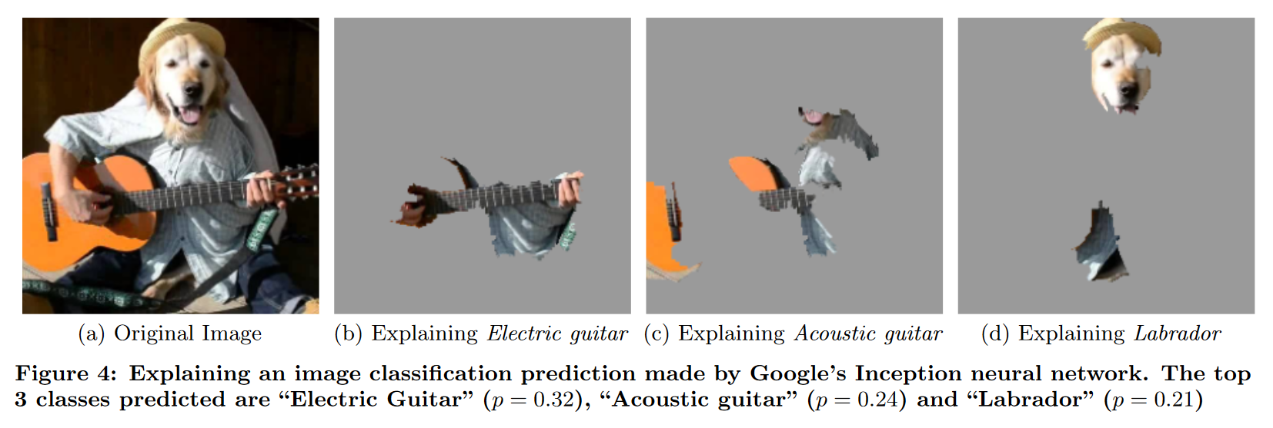
Explaining a Single Image Classification (Local)
Taken from Ribiero et al. "'Why Should I Trust You?' Explaining the Predictions of Any Classifier," KDD 2016 https://dl.acm.org/doi/pdf/10.1145/2939672.2939778

Slide 17
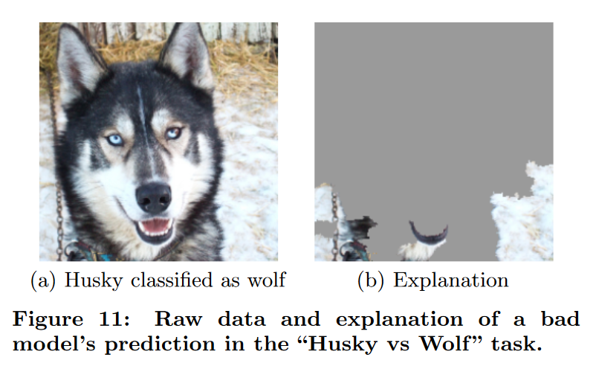
Retrospective Explanations of Images
Taken from Ribiero et al. "'Why Should I Trust You?' Explaining the Predictions of Any Classifier," KDD 2016 https://dl.acm.org/doi/pdf/10.1145/2939672.2939778

Slide 18
Retrospective Explanations of Images
Taken from Ribiero et al. "'Why Should I Trust You?' Explaining the Predictions of Any Classifier," KDD 2016 https://dl.acm.org/doi/pdf/10.1145/2939672.2939778

Slide 19
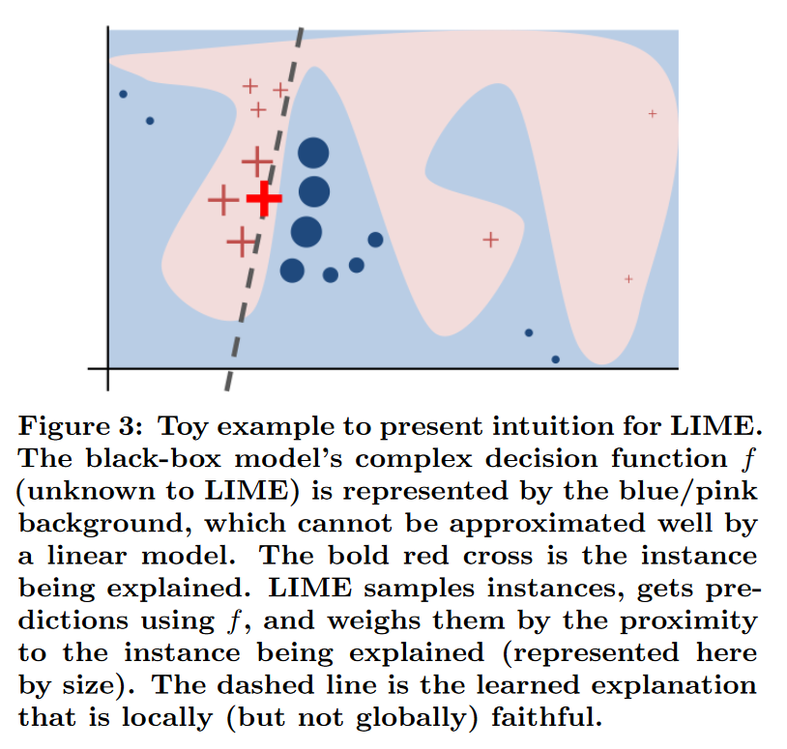
Local Explanations Despite Global Complexity
Taken from Ribiero et al. "'Why Should I Trust You?' Explaining the Predictions of Any Classifier," KDD 2016 https://dl.acm.org/doi/pdf/10.1145/2939672.2939778. See also Rudin, “Stop explaining black box machine learning models for high stakes decisions and use interpretable models instead,” Nature Machine Intelligence, 2019. https://arxiv.org/pdf/1811.10154

Slide 20
Business Applications

Slide 21
Information to Potentially Include
The general approach taken
The precise factors taken into account
Do we provide access to the data subject’s own values?
Do we explain how those factors are combined?
Do we explain the ML model used?
Do we open-source the ML model?
Counterfactuals – “If X had not occurred, Y would not have occurred”
What could a person have changed for a different classification?
Can we define some distance function and show the smallest change?

Slide 22
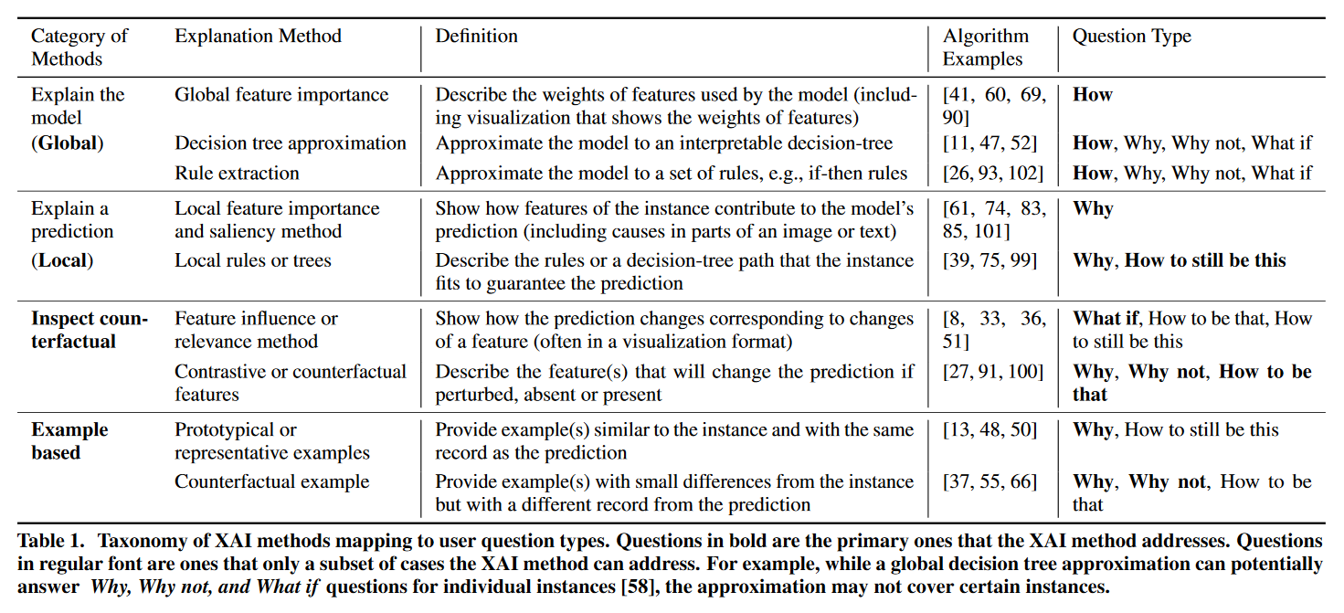
Broad Approaches
Taken from Liao et al. “Questioning the AI: Informing Design Practices for Explainable AI User Experiences,” CHI 2020.
https://dl.acm.org/doi/pdf/10.1145/3313831.3376590

Slide 23
What Explanation Would You Give?
A classifier for potential phishing emails
A classifier for images that represent hate speech
A classifier that detects DDoS attacks on your network
To whom do you owe an explanation?
What can technical users learn from the explanation?
What can non-technical users learn from the explanation?
What can attackers learn from the explanations?
What can cause your explanations to end up in a newspaper?

